Slide 1

“The Enhancement of Entrepreneurship in Sudan: Opportunities Post INSO Project”
IRISS-CNR
Sala Convegni - Via G. Sanfelice, 8 Napoli
15 February, 2019 – 10:30

Slide 2
The role of Research Institutions to the development of entrepreneurship in Sudan
Rashid Abdelhaleem SAEED ABDELHALEEM,
Scientific Research and Innovation Commission (SRIC), Ministry of Higher Education and Scientific Research (MOHE)
Institute

Slide 3
Agenda
Introduction
Update of Sudan STI polices
Sudan STI Structure
STI indicators
Sudanese Research Priorities
Strive for STI implementation in MOHE

Slide 4
Introduction
Entrepreneurship is an indicator of the innovation index in the country
STI based-Entrepreneurship is more resilience with high opportunity of survive
Entrepreneurship is not a training, it is all about startup and business
MOHE’s STI vision is a research and development that leads to Entrepreneurship outcomes, through various components,

Slide 5
History of Sudan STI (SSTI)
STI entity | Year
Gordon Memorial College (GMC) was founded | 1902
The establishment of Agricultural Research unit (ARU) | 1904
ARU switched to the Agriculture Department | 1919
The GMC college was affiliated with The University of London | 1947
Gordon Memorial College was formally renamed University College Khartoum | 1951
Khartoum University College turned to the University of Khartoum | 1956
the establishment of the Agricultural Research Corporation | 1968
The establishment of the National Research Center (NCR) | 1970
The establishment of the Ministry of Higher Education and Scientific Research (MOHE) | 1991
The establishing the Livestock Research Commission. | 1996
The establishment of the Ministry of Science and Technology | 2001
The establishment of the ministry of science and telecommunication | 2011
STI returns back to MOHE | 2015
The establishment of scientific research and innovation commission as an executive arm STI in MOHE | 2015
The establishment of Scientific research, technology and innovation council | 2016

Slide 6
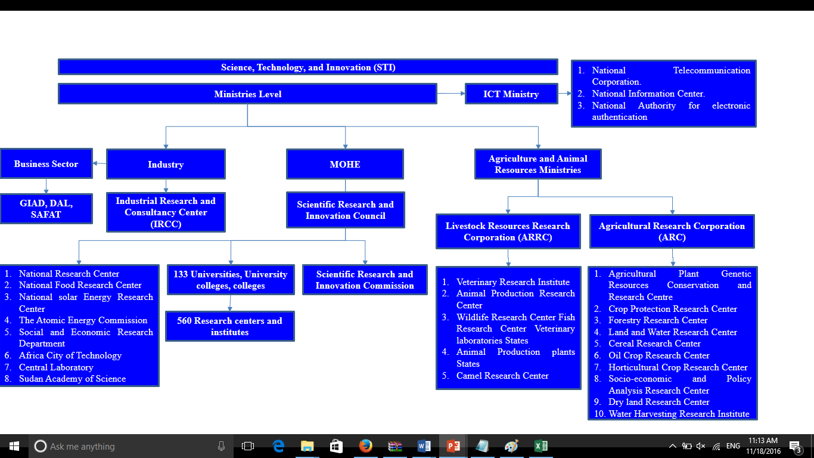
Structure

Slide 7
Ministry of Higher Education and Scientific Research
MOHE
Scientific Research and Innovation Council
Scientific Research and Innovation Commission
National Research Center
National Research Center for Energy
National Food Research Center
Center
The Atomic Energy Commission
Social and Economic Research Department
Africa City of Technology
Central Laboratory
Sudan Academy of Science
133 Universities, University colleges, colleges
560 Research centers and institutes

Slide 8
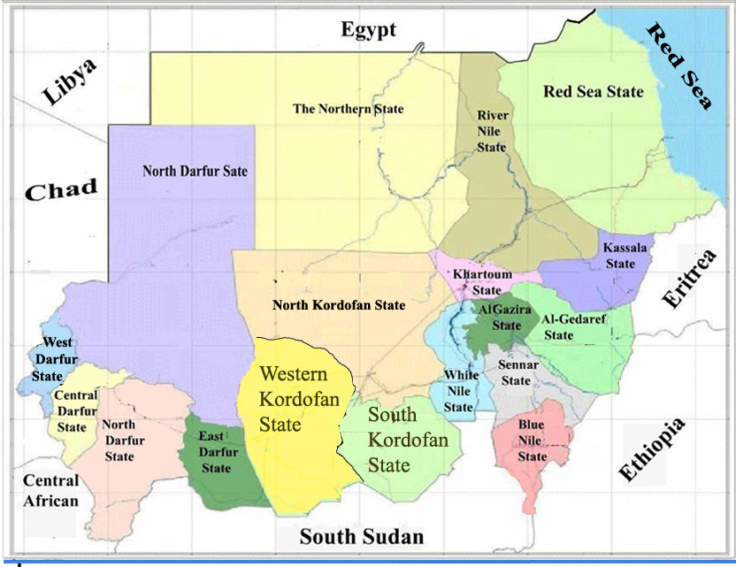
Unique Geographical Distribution
Public Universities
34
2
2
Universities,
at least one in
each state
10
4
2
2
2

Slide 9
Unique Geographical Distribution
non-governmental Institutions
More than 100
Universities and colleges
Mostly in Khartoum
3
81
9
3

Slide 10
Unique Geographical Distribution
Technical colleges
More than 20
1
1
1
1
1
5
Technical colleges
Merged into Sudan Technical university
3
1
1
1
1
2

Slide 11

Innovation system

Slide 12
STI Structure
STI Observetory
???
STI Council
STI
Scientific Research Committee
SRI Agency
Publication Committee
SR Ethics Committee
Innovation Committee
?????
Research Projects Funding Committee
IPO
NTTO
R&D institutes
Universities
COE
Research Chairs
Promotion and Commercialization
Africa Technology City
SAS
Central Lab

Slide 13
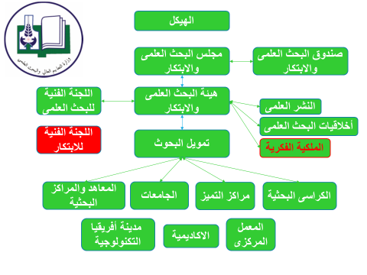
STI R&D Institutes
Industry (P&P)
Bridges
ARRC
ARC
International Fund Agencies
NGOs

Slide 14


Slide 15
Average student's intake per year for Sudanese universities in various levels.

Slide 17
The average number of staff in Sudanese universities

Slide 19
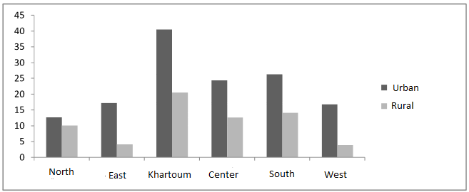
Internet Penetration in around the country

Slide 20
MOHE’s Research Priorities
1. Manufacturing of Local Resources
2. Water harvesting
3. Renewable Energy
4. Power Systems Planning
5. improve energy transmission and distribution
6. foundations and building materials
7. Mining Research
8. Wastewater
9. types of cancer-causing Sudan and the challenges of the services provided
10. nutritional problems and their determinants middle of mothers and children
11. microbes resistant to antibiotics and rationalize consumption
12. neglected diseases

Slide 21
MOHE’s Research Priorities
13. Upgrade Sudanese personal behavior and maintain their value
14. Encyclopedia Sudanese cities
15. improve quality and productivity and reduce the cost of strategic crops
16. maximizing the yield of horticultural exports series
17. Combat Desertification
18. population mobility.
19. language teaching policies in Sudan
20. dimensions of economic and social Mining in Sudan and its impact on the environment.
21. value-added metals
22. sustainability of production and the welfare of the animal under the climatic variables.
23. eugenics ruminants and the development of fish production and wildlife.
24. Food safety of animal origin.

Slide 22
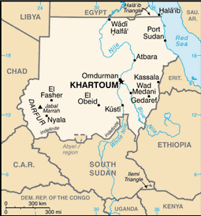
Date Palm
Cancer
Archology,
Mining
Marine research
Mining
DL Research
immigration
Research Potentials in Sudan
Camel research
Gum Arabic
Animal Production
Minerals
Field and horticultural crops
Neglected tropical diseases
Water conservation

Slide 23
STI Update
United Nations Educational, Scientific and Cultural Organization (UNISCO). It was based on a few areas:
To enhance the role of knowledge based economy.
To strengthen role of partnerships between research, development, and innovation at universities and R&D centers on the one hand and between industries and services companies at the other hand.

Slide 24
To stress on the impact of the innovation in the sustainable development.
To promote demand of R&D and innovation at the state level and increase STI awareness among public.
To transfer knowledge into wealth through R&D and innovation.
To develop scientific curriculum and conversion of some universities and institutes to be technological oriented

Slide 25
Sudan STI Objectives:
Building a knowledge society by integrating science, technology and innovation with national development policies and strategy of economic reform in Sudan.
A culture of science, technology and innovation at the grassroots level.
Improve surveillance and foresight and forward-looking system.
Ward off the risk of environmental threats to the optimum use of natural resources.

Slide 26
Sudan STI Objectives:
Capacity building in basic research.
Promote research in the energy and modern technologies and bio-technologies and space sciences and renewable energies and informatics areas.
Focus on research programs and projects with a direct impact on development.
Develop and localize and deployment of technology in the industry systems in the public and private sector organizations.
Closer cooperation and participation in the relevant research institutions locally, regionally and internationally relationships.

Slide 27
The Fundamental Pillars for STI:
Mitigate the effects of poverty, one of the Sustainable Development Goals (SDGs)
Give priority to science, technology and innovation in strategic and 2017 – 2020
Identify the priorities of scientific and technological research in line with the sustainable development goals (SDGs)
Strengthen the link between the components of society in the public and private sectors
Encourage publication in prestigious world scientific journals
the intellectual property

Slide 28
Tools and Mechanisms
Review the structure of STI development, plans, policies and stratifies.
Establishment of new bodies that complete the STI cycle from grass-roots researchers up to industry.
Develop a policy for research fund with allocation of at least 1% of the total Gross domestic product (GDP)
Develop incentive legislation for the private sector to participate in the development of STI
Creation of technological cities, incubators, museums and science and technology parks.

Slide 29
Flexibility of national Funding
Centralized national funding mechanisms
Possible co-funding mechanism
Diversity of funding opportunities
  Young researchers program;
  National research projects
  Prizes
  others

Slide 30
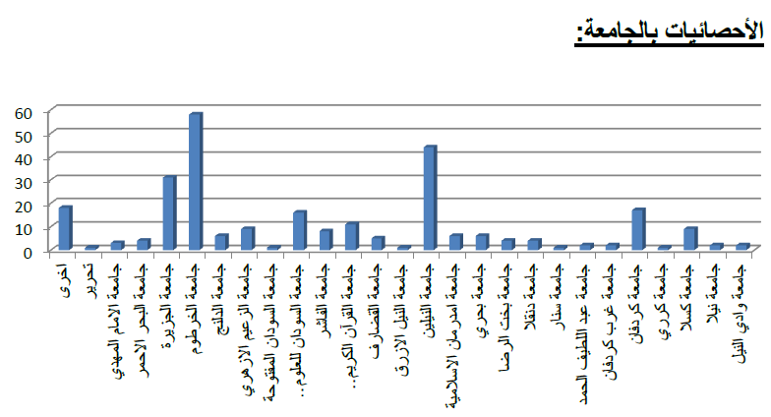
772 Proposals were received

Slide 31
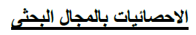
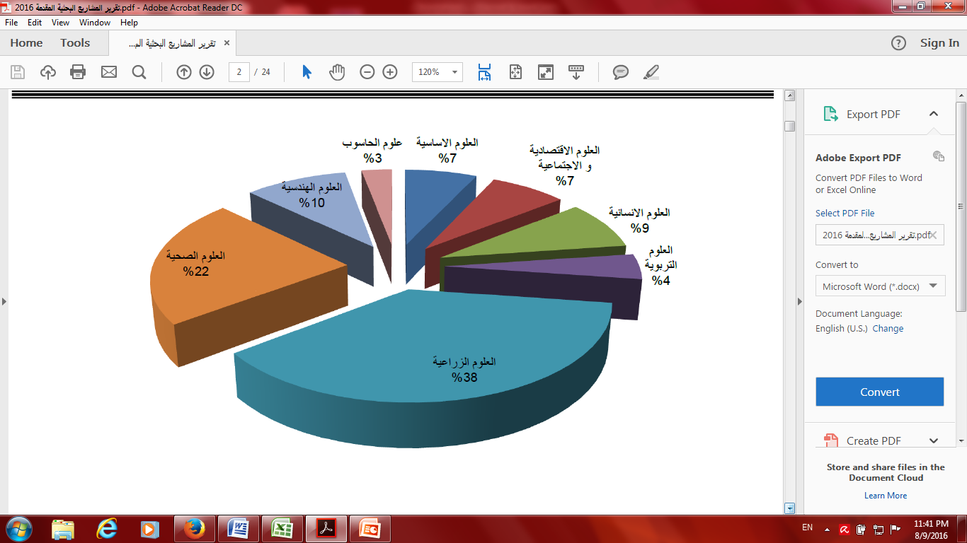

Slide 32
Amount per Fields

Slide 33
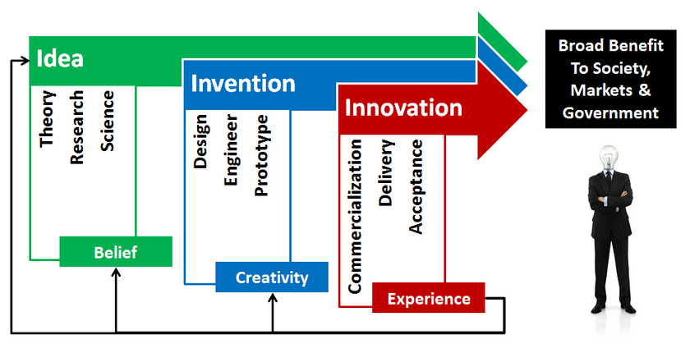
III

Slide 34
What is Technology Transfer?
Technology readiness level (TRL)
Maturity ideas products companies
1 2 3 4 5 6 7 8 9 10
‘SKILLED’
TRANSLATORS
Technology
Generators
Technology
Transfer
Facilitators
Technology
Seekers
Universities
Research Institutes
SMEs
Large Companies
Government
Research Funders
Investors
Science Parks
Start-ups
SMEs
Large Companies
Government
The basic idea is to source, develop and commercialise technologies….

Slide 35
Roadmap
IP & Patent
Basic Research
Development
Money and Economy
Applied Research
Technology Transfer
R&D Institutes
Technology parks
Companies
Incubators
Universities

Slide 36
Transfer Technology Cycle
R&D
Incubator
Invention
Spin off Co.
Evaluation
Licensing
IP Protection
Marketing

Slide 37
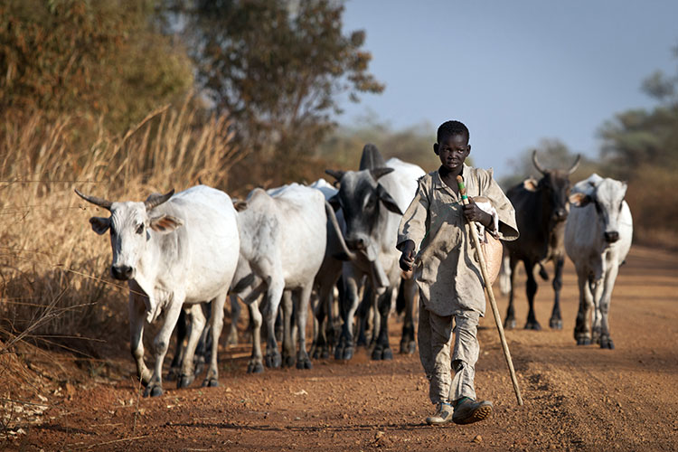
Center of Excellence (13)
Gum Arabic and Desertification studies center
Weed Science center
Islamic Knowledge Center
National University Research Center
Pease Research Center
Tuberculosis Center
Remote Sensing Research Center
Mycetoma Research Center
Endemic Diseases Research Center
Molecular Biology Research Center
Water Harvesting Research Center
Nobri Research Center for Oilseeds
Pesticide and Plant Health Research Center

Slide 38
Research chairs (4)
Archeology
Gum Arabic
Water harvesting and desertification
Environmental Studies

Slide 39
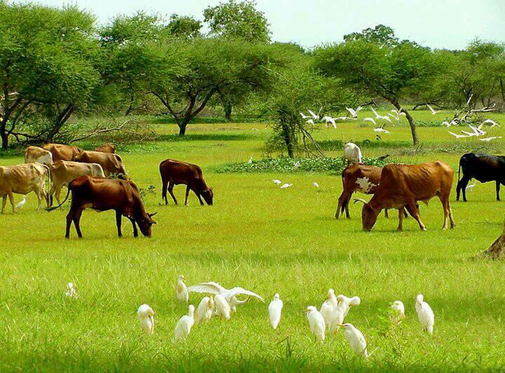
Research groups (8)
Work on large priority projects according to the national development plan;
  Research group in food security
  Research group in Cancer
  Research Group in Archeology
  Research group in Mycetoma
  Research group in Forestry products
  Research group in Metabolic
  Research group in Sugar Studies
  Research group in Early Alarm System

Slide 40

Incubators (15)
Animal and Milk Production incubator
Oilseed incubator
Renewable Energy incubator
Medicinal herbs incubator
Fish farming incubator
Nanotechnology Incubator
3D Printing incubator
Food production incubator
Leather production incubator
Software Engineering Incubator
Cyber Security Incubator

Slide 41
Now

Slide 42
Vision

Slide 43
Conclusions
Incubators are the main driver for entrepreneurship enhancement
Systematic and strong R&D activity leads to strong entrepreneurship system
Entrepreneurship is the main goal and outcome for STI policies and plans
With more than 140 universities and colleges entrepreneurship is a must

Slide 44


Slide 45


