Slide 1
“The Enhancement of Entrepreneurship in Sudan: Opportunities Post INSO Project”
IRISS-CNR
Sala Convegni - Via G. Sanfelice, 8 Napoli
15 February, 2019 – 10:30

Slide 2
The strategic role of CCST in the implementation of the INSO incubator
Jorge NARANJO ALCAIDE Comboni College of Science and Technology

Slide 3
Introduction
How the INSO Project led Comboni College of Science and Technology (CCST) to the preparation of a Start-ups Incubator.
Meeting after last Congress on 22nd November 2017 among MOHE and CCST teams, Prof. Alfonso Morvillo and Dr. Chiara Impagliazzo, to discuss about the best way to give continuity to the Project.

Slide 4
1. Why an Incubator
The reasons to think of the Incubator as logical consequence of INSO project can be drawn from the analysis of the following elements:
the structure of the Sudanese labour market;
the curricula of university studies in Sudan;
the challenges that start-ups usually face;
the feedback of the trainers who worked with the students of the project.

Slide 5
1.1 The analysis of the structure of the Sudanese labour market
Fundamental elements:
the dominance of public sector in total employment;
the demographic structure with a very rapid growth and very high percentage of young population;
the low skill level and brain drain problems;
the increasing rate of unemployment;
and the mismatch between the educational offer and the labour market.

Slide 6
1.2 University studies Curricula and trainers feedback
“Generally, entrepreneurship is not encouraged as a professional career and this is reflected in the lack of a national plan for developing entrepreneurship and by the small number of technical secondary schools (98) versus academic secondary schools (3.128)” (Darbo& Eltahir, 2017, p. 292).
“The teaching of entrepreneurship education is not yet sufficiently incorporated into higher education institutions’ curricula in Sudan” (Timan & Gangi, 2015, p. 244).
Meridies Program: Innovation, Business Planning, Leadership, Entrepreneurship and Sustainability.
New BSc in IT

Slide 7
1.3 Start-ups challenges
Lack of know-how of university students in relation to the transformation of their business ideas into effective companies. “Start-ups frequently show lack of management knowledge and management skills (particularly in the case of technology- oriented ventures)” (Allen and Rahman 1985; Smilor 1987; quoted by Roseira, Ramos, & Maia, 2014, p. 4).
Lack of visibility in the market.
Lack of connections.

Slide 8
2. Analysis of the Environment
2.1 Public Initiatives in Sudan: SUST + Samiqat, “Technological Park” at the Merowe-Abdulatif Al-Hamad University of Technology; Information Security and Software Engineering Incubator Project at MOHE; Entrepreneurship Center of the School of Administrative Sciences of the University of Khartoum.
2.2. Private Initiatives in SuDAN
Impact Hub Khartoum: they work on providing co-working spaces as well as incubator & accelerator programs for entrepreneurs (March 2017).
249 Start Up is a Sudanese enterprise that also provides co-working spaces in Khartoum with shared desks, private offices, all with high-speed internet access. They have international and local mentors in a curriculum designed to promote growth for the entrepreneurs and startups. They are running an Acceleration Programme in collaboration with Haggar Company and they inaugurated an Incubation Program in collaboration with the Embassy of the Netherlands on 18th November 2018 (Orange Corner). This program offers funds to 20 selected young entrepreneurs.

Slide 9
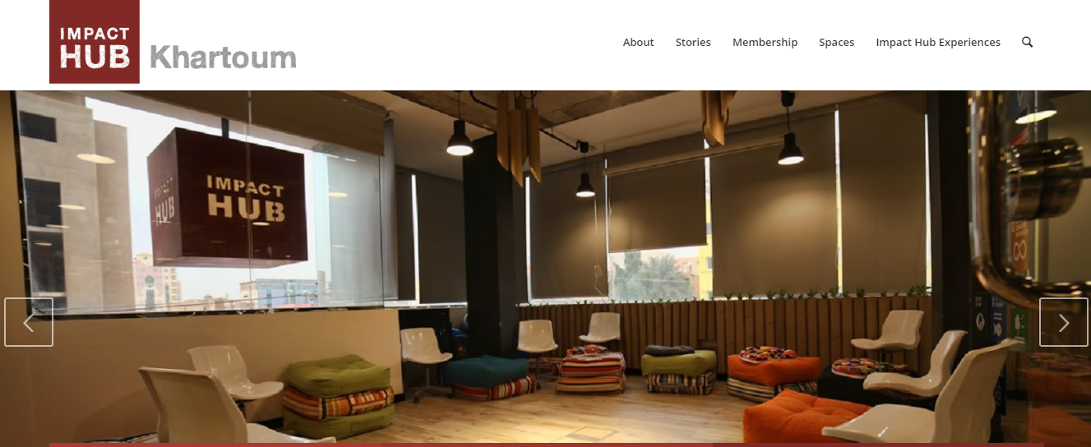
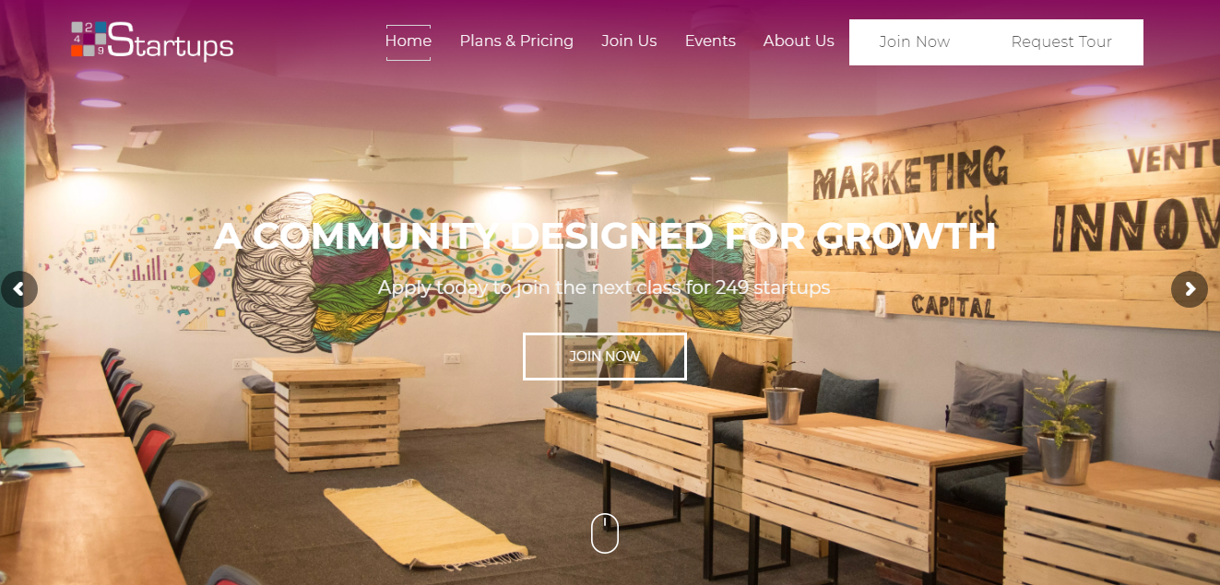
2.2 Private Initiatives in SuDAN

Slide 10
2.3 University Incubators

Slide 11
2.4 INSO Incubator SWOT Analysis
Strengths | Weaknesses
The incubator is associated to CCST which is ready to share resources like staff specialized in Computer Science and Business Administration; infrastructure (library, meetings room, Conference Hall ...etc); contacts and national and international partners (MOHE, IRISS, UPV,…). It is planned to be self-sustainable without dependence from foreign financial support. Affordable price | Small number of graduation projects per-year. Small numbers of hosted projects.
Opportunities | Threats
Small number of technological incubators in Khartoum. | Risk of potential failure of projects after incubation period is over. Unclear taxing and banking system which may lead to false numbers on profit share. Low numbers of eligibility projects.

Slide 12
3. Strategic Planning
Mission
CEIC is an incubator associated to CCST that supports the creation of micro-companies by young entrepreneurs with the goal of fostering sustainable and community development.
Vision
CEIC intends to promote peace building and social inclusion through community development of university students and graduates particularly from peripheral and marginalized areas.
Values and purpose
Social cohesion and integration through human capital enhancement.
Diminish unemployment and generate local sustainable development.
To propose a concept of entrepreneurship that considers the social and environmental impact of the entrepreneurial activity and is inspired by Circular Economy models.
Add a value proposition to the CCST

Slide 13
4. Service Description
Pre-incubation | Incubation | Acceleration
Basic training and overview to wake up the hidden entrepreneurs. (Short Term) | Hardworking training and accompaniment to enhance the skills of future leaders. (Middle term) | Networking investors’ platform to consolidate business operations and reduce timeframe. (Long Term)
From April 2019 | From 2020

Slide 14
Criteria for the Selection of Projects
Priority will be given to projects that:
Have technological basis;
Are innovative and have potential for growth;
Have capacity to create jobs;
Solve a real problem;
Meet a market need;
Are managed by the community;
Have potential to strengthen and diversify the economy;
Generate social and economic benefits for the community at a short and long term;
Are compatible with the Circular Economy framework;
Are located in marginalized areas.

Slide 15
5. Organizational Structure AND JURIDICAL STATUS
The National Council of Higher Education and Scientific Research has just approved on 5/2/2019 a Bylaw to Regulate the Work of Incubators in Institutions of Higher Education and Scientific Research.
The Bylaw defines a quite flexible legal work that encourages creativity, research and innovation. CEIC Incubator shares this ends but has also a strong social character. Social and environmental impact, community development, entrepreneurship and circular economy are also fundamental concepts that will shape the activity of the Incubator.
Board of Directors + Technical Advisory Committee (IRISS?) + Director + Deputy Director + Some assisting staff.
To start: Two full time positions that will work as a team and share responsibilities.

Slide 16
6. Project Sustainability
Commission Model: the incubator will sign a contract with the incubatees by asking them a commission of the future revenues of their businesses.
Incubator activities: Workshops, conferences and competitions can be organised in order to complement the formation to the entrepreneurs.
Local sponsors: JTI
Haggar HoldiNG

