Slide 1
“The Enhancement of Entrepreneurship in Sudan: Opportunities Post INSO Project”
IRISS-CNR
Sala Convegni - Via G. Sanfelice, 8 Napoli
15 February, 2019 – 10:30

Slide 2
The Sustainability of an Incubator: The Experience of the E4Impact Foundation in Africa
Fabio Petroni, Director of Programs E4Impact Foundation – Catholic University of Sacred Heart

Slide 3
E4Impact Foundation
The E4Impact project was launched in 2010 by ALTIS, the Graduate School Business and Society of Università Cattolica del Sacro Cuore (UCSC) of Milan, the largest private University in Europe.
In 2015, the project originated a Foundation as a spin off of Università Cattolica del Sacro Cuore, thanks to the involvement of some of the most important Italian companies.
Board Members:
Letizia Moratti (President)
Franco Anelli (Vice-President)
Diana Bracco
Gaetano Castellini
Gian Maria Gros Pietro
Mario Molteni (CEO)
Andrea Perrone
Alberto Piatti
Pietro Salini
Giorgio Squinzi

Slide 4
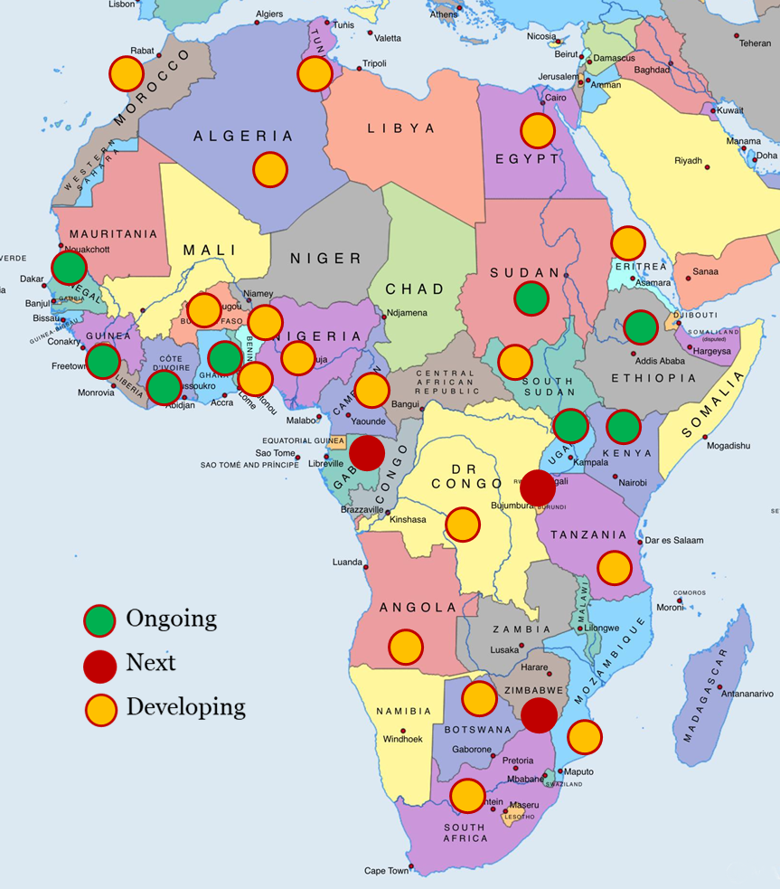
The E4Impact growth
The Foundation currently offers the MBA in Impact Entrepreneurship in 9 African countries: Kenya (2010), Ghana (2013), Sierra Leon (2014), Uganda and Ivory Coast (2015), Senegal (2016), Ethiopia (2017), Sudan (2018), Zimbabwe (2019).
In 2019 the program is expected to start in 2 new countries: Gabon and Rwanda.
The goal is to reach:
At least 15 African countries by 2020
Different Regions in the same country
E4Impact aims to establish the leading African University Alliance for Impact Entrepreneurship

Slide 5
Alliance at present
Università Cattolica del Sacro Cuore Milan - Italy
Tangaza University College Nairobi - Kenya
Uganda Martyrs University Kampala - Uganda
Catholic University of Zimbabwe Harare
University of Makeni Makeni - Sierra Leone
St Mary’s University Addis Ababa - Ethiopia
CERAP Abidjan – Côte d’Ivoire
ISM Dakar - Senegal
University of Professional Studies Accra - Ghana
University of Medical Sciences and Technology Khartoum - Sudan

Slide 6
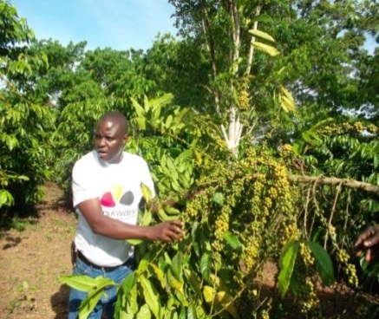
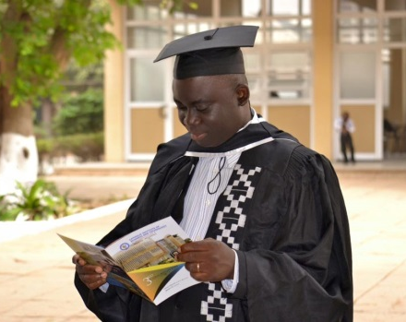
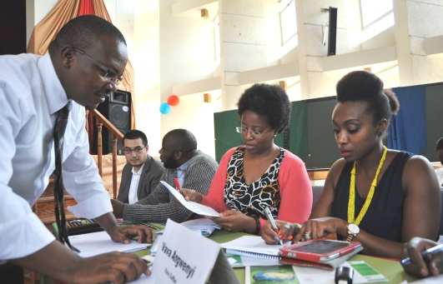
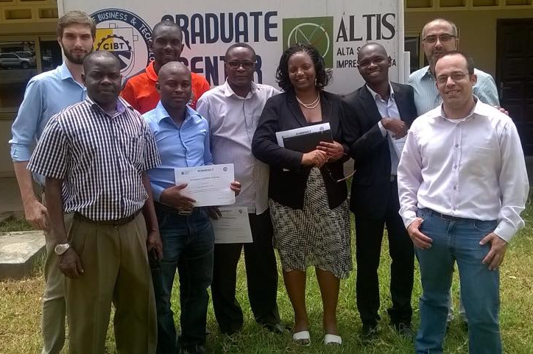
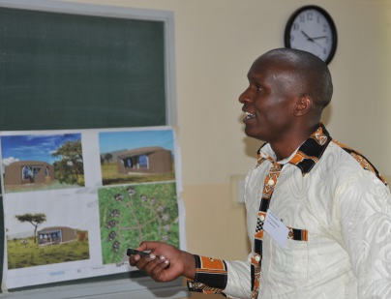
The MBA
MBA + Business acceleration experience
Blended formula: 37 days on Campus + Distance Learning
For working people
High quality at affordable price
International MBA Degree by UCSC-ALTIS
“Business Coach” for one-to-one consultancy
Women and youth entrepreneurship
Part of a Pan-African System

Slide 7
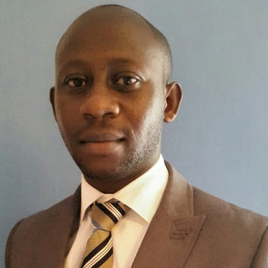
IMPACT
800+
IMPACT ENTREPRENEURS
37%
WOMEN ENTREPRENEURS
75%
ALUMNI WITH A BUSINESS IN PLACE
4.000+
JOBS PROVIDED BY ENTREPRENEURS
200.000+
LIVES BENEFITTED BY ALUMNI BUSINESSES

Slide 8
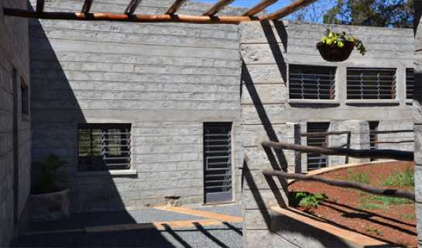
Beyond the MBA: The Incubator
Funded by the Italian Agency for Development Co-operation, the E4Impact Foundation has launched in Kenya the E4I Incubator which hosts 20 Kenyan businesses each year for two years to:
Support their growth
Increase their revenues
Guide them toward profitability and impact
Provide them partnership access to Italian businesses

Slide 9
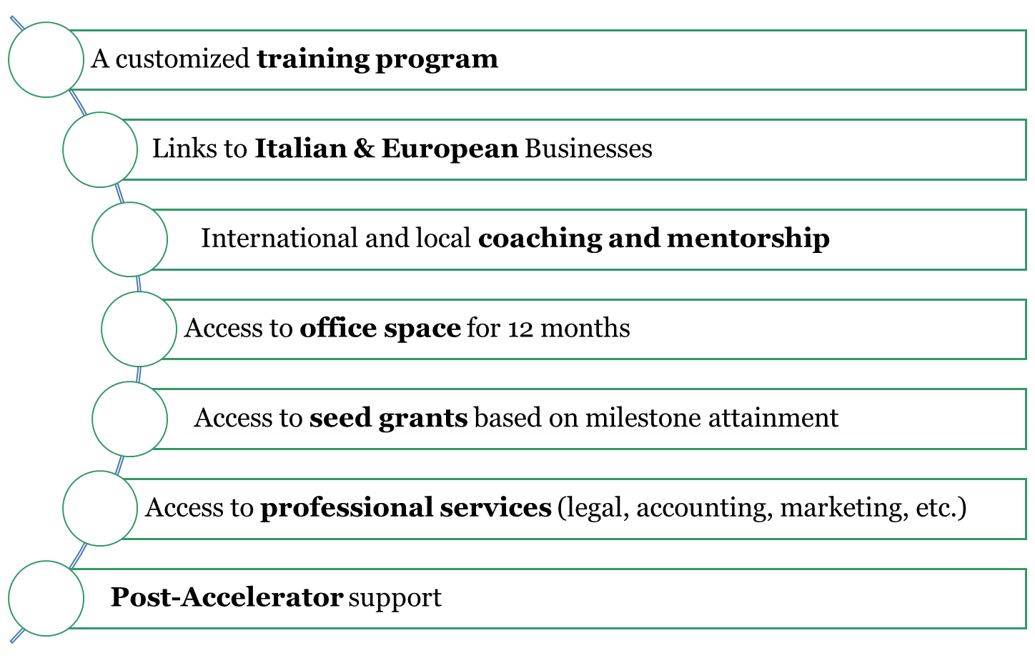
Key Services

Slide 10
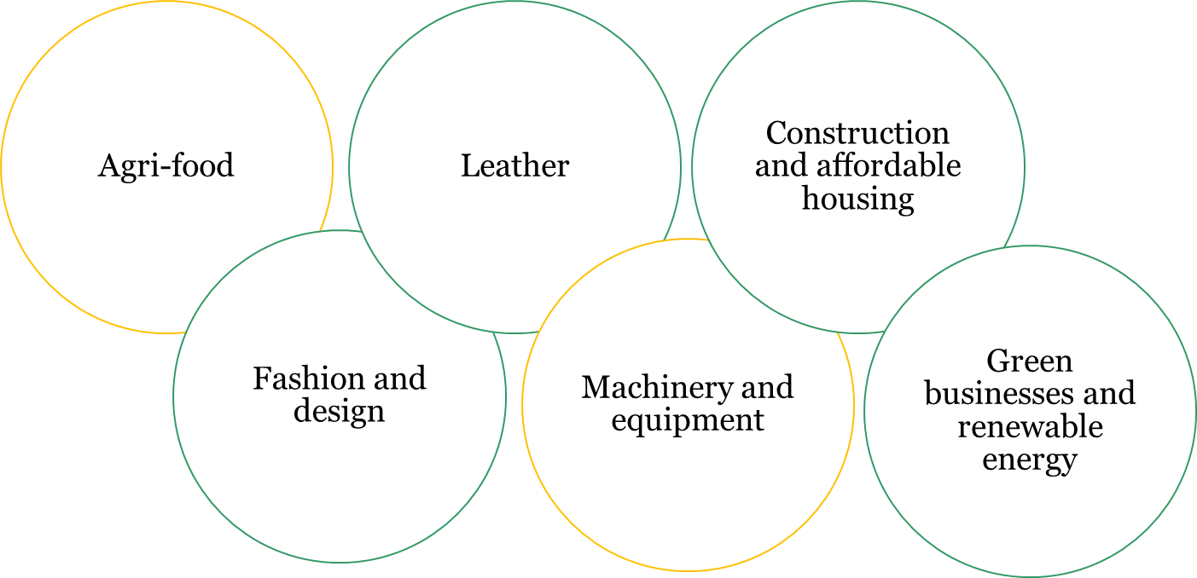
Key Sectors
The Accelerator is open to all sectors, but has a preference to:
the Italian excellences
Kenyan “Big 4Agenda”
manufacturing
universal healthcare
affordable housing
food security

Slide 11
The Challenge: Economic Sustainability
Rent
Monthly or Yearly Fixed Fee Spaces and utilities
High Competition
Ability to pay
Royalty
Yearly % of turnover increase
Very limited accountability
Incubatees
Deferred Debt
Within 10 years Fixed amount
Cash flow issues @ incubator
Equity (industrial)
T0 = 0; T1 = € 5-10% equity → % revenues
Very Long term Not sustainable at start
Equity (financial)
2-3+ years Exit
Too risky for Int. Investors DD very expensive
Investors
Success fee
Once off from investors Fixed fee Vs Investment %
Too risky for Int. Investors DD very expensive
Donors
Grant
Impact Based
Cannot last forever

Slide 12
Looking for Sustainability
High performing incubatees
No revenues from incubatees
Internationalization
Related Services
Grants
Strong Brand
Good economic results
Big Four and MBA integration
Good Social Impact
Links with Italy
Export success fee
Dev. Coop. Projects
Training for other businesses
Consultancy with PA bodies

Slide 13
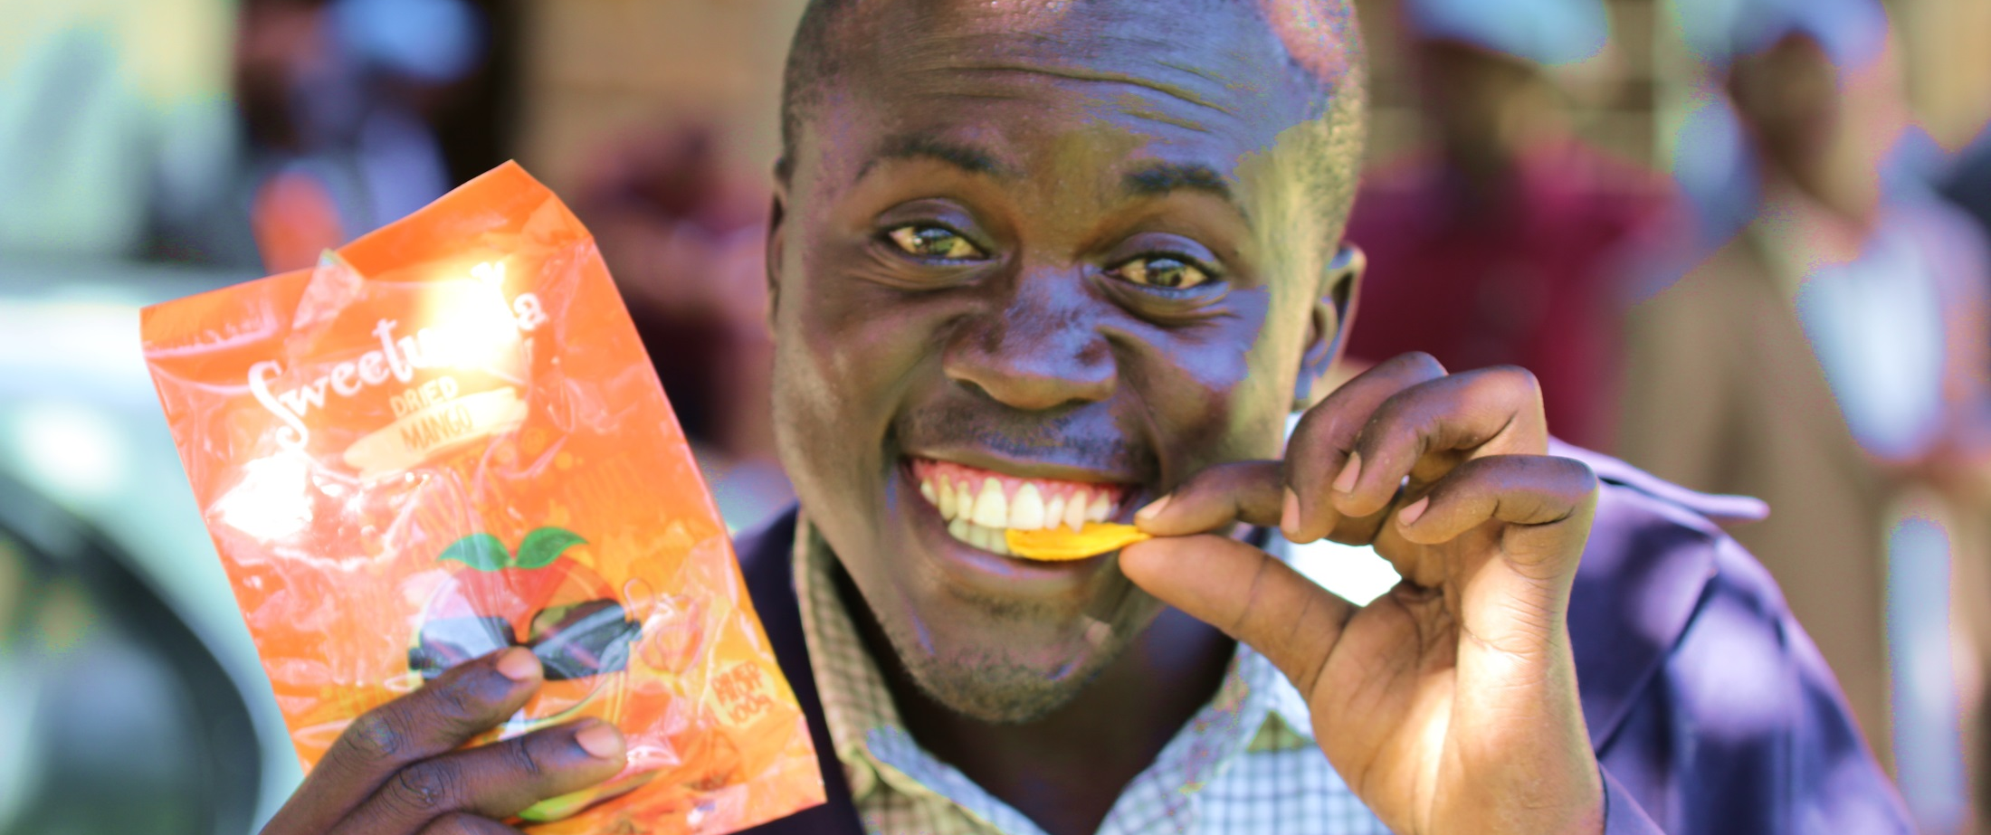
Sweetunda
Natural goodness from Kenyan farmers

Slide 14
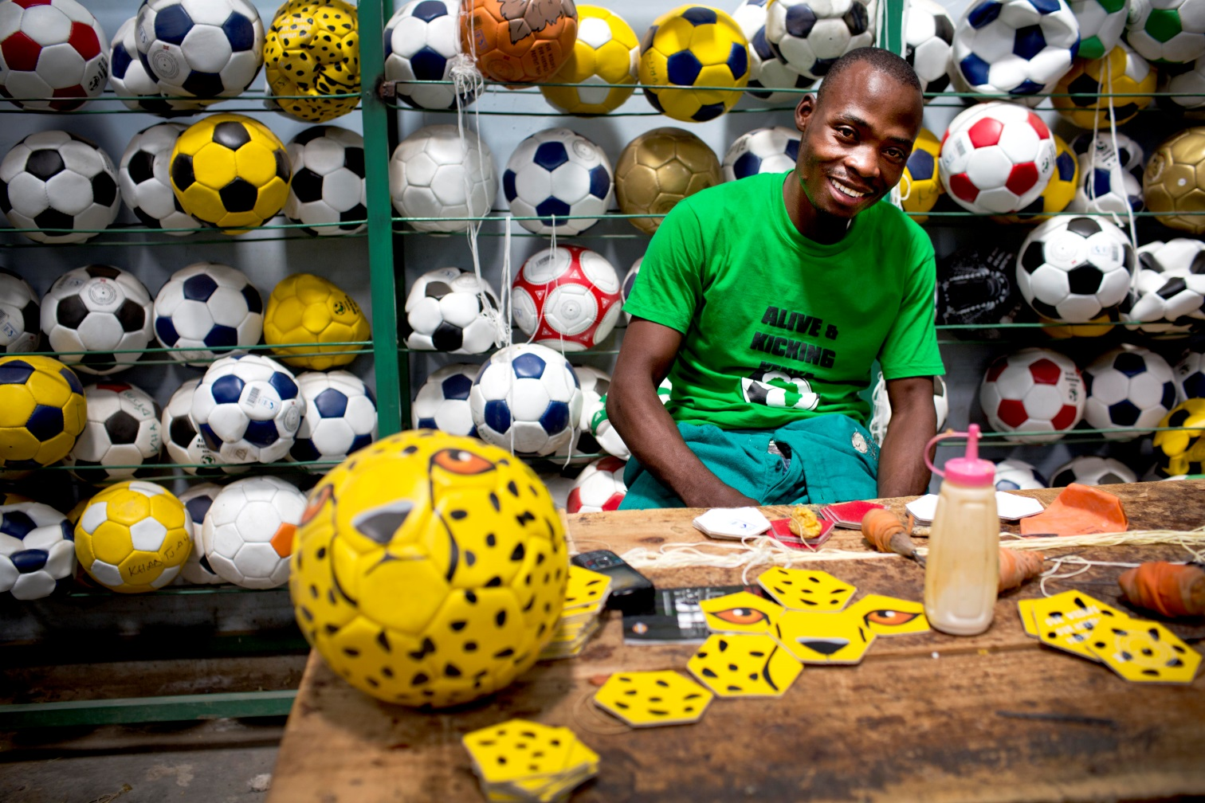
Alive and Kicking
We make durable sport balls in Kenya
We print them with messages.
We play.
We educate about health.

Slide 15
Thank You!
Fabio Petroni
Director of Programmes
+39 392 07 01 530
fabio.petroni@unicatt.it

